Slide 1

教学辅助课件
牛津 七年级下

Slide 2


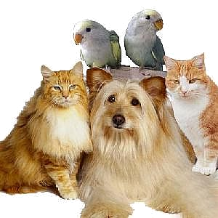

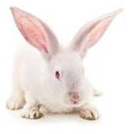
Unit 8
Pets
Welcome to the unit

Slide 3


Words review
pet
rude
goldfish
mouse
parrot
knee
hold
feed
teach
n. 宠物
adj. 粗鲁的，不礼貌的
n. 金鱼
n. (pl. mice) 老鼠，耗子
n. 鹦鹉
n. 膝，膝盖；
坐下时大腿朝上的面
vt. 握住，拿
vt. 喂，喂养
vt. 教
Read after the tape and speak out the Chinese immediately.

Slide 4

Objectives
To know six different pets (cat, dog, goldfish, mouse, parrot & rabbit) and their typical features
To be able to talk about your favourite pet and explain why you like it
To learn the new words and useful expressions

Slide 5

Focus on
Words:
pet mouse knee hold feed teach rude goldfish parrot
Expressions:
bring me something to eat
swim around play with
sleep on my knees hold it in my hand
feed her carrots teach him to speak

Slide 6
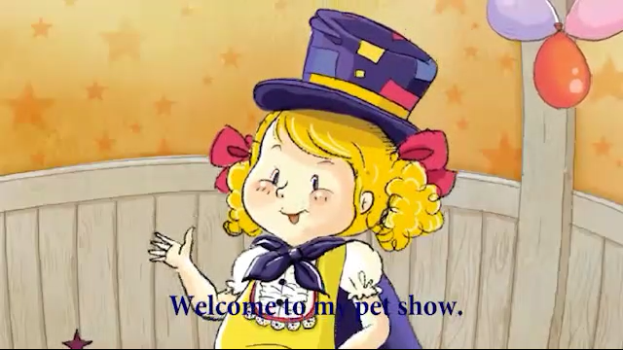

What pets can you see in this video?
dog
hamster
cat
parrot

Slide 7

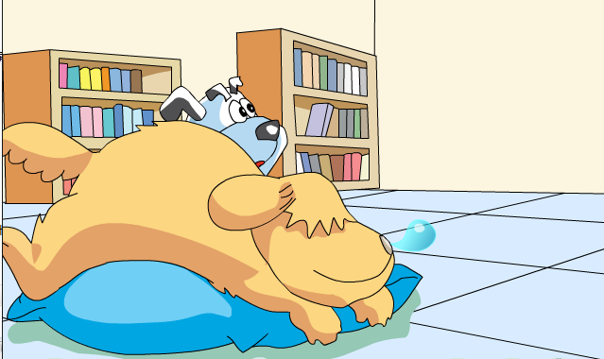

Eddie also has a pet. It’s Hobo. Why does not Hobo bring Eddie anything to eat at first?
Because he thinks Eddie is too rude.

Slide 8

Read and answer
1.What does Eddie want Hobo to do?
He asks Hobo to bring him something to eat.
2.Is Hobo happy? Why?
No, because Eddie didn’t say “please”.

Slide 9
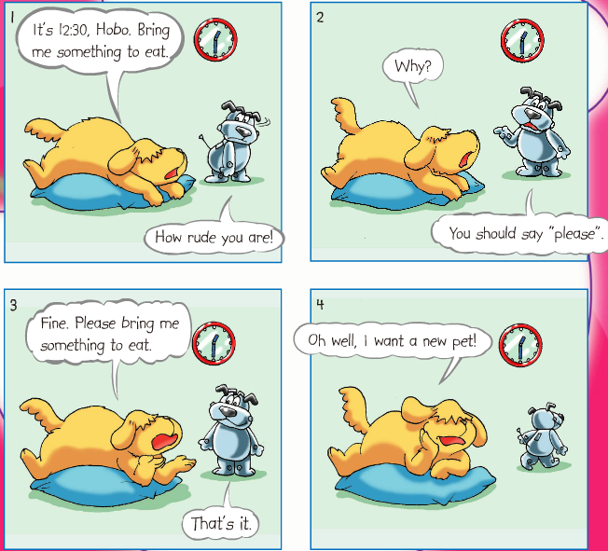
Observe-and-explain
that’s it: used to say that sth is correct
这就对了；正是这样
eg: That's it. Let’s tell her news when we see her.
对，我们见到她的时候把这消息告诉她。

Slide 10
Act it out
1. Use different tones (语气).
2. Add your own actions to make the dialogue more interesting.

Slide 11

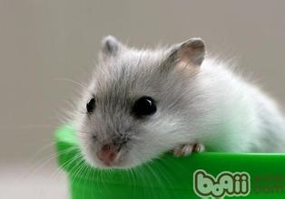
Guessing game:
Many people hate me.
I like eating rice.
Cats are my enemies.
Mouse

Slide 12

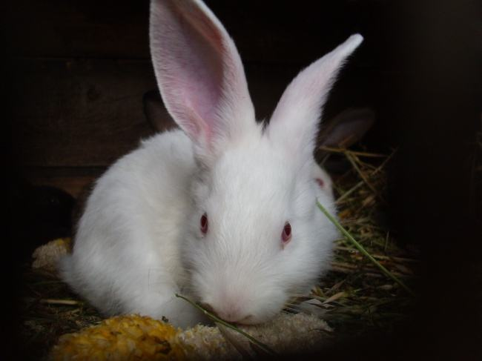
Guessing game:
I run quickly.
I have long ears and short tail.
I have red eyes.
I like to eat carrots.
Rabbit

Slide 13

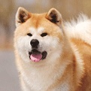
Guessing game:
I have four legs.
I’m very smart and I like to play.
I like to smell things.
I can wag (摇摆) my tail.
I can protect my master’s home.
Dog

Slide 14

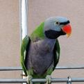
Guessing game:
I have a tail.
I can fly.
I have colorful feathers.
I can sing and speak.
Parrot

Slide 15
Guessing game:
I can swim very well.
I can’t live without water.
I sleep with my eyes open.
I am orange or red.
Goldfish

Slide 16
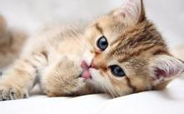
Guessing game:
I have four legs and a long tail.
I have sharp teeth and claws.
I like to chase mice.
Cat

Slide 17

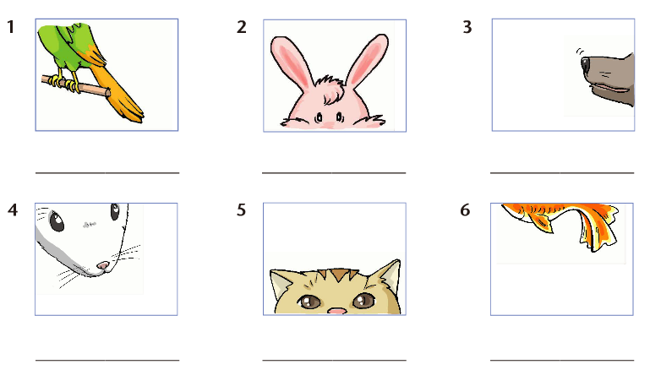
cat
dog
goldfish
mouse
parrot
rabbit
The students drew some pictures of their pets. Look at the parts of the pictures and write the names of the animals under them. (P 93)
A
A

Slide 18
a I like watching them swim around.
Daniel: I love my parrot because ___
Kitty: I like my rabbit because ___
Peter: I like goldfish because ___
Sandy: I like my mouse best because ___
Millie: I love my dog because ___
Amy: I like my cat because ____
f
b she loves to sleep on my knees.
d
B
The students are talking about why they like their pets. Match the two parts to make correct sentences. Write the correct letters in the blanks. (P 93)
c it’s very small and soft
and I can hold it in my hand.
a
d I can feed her carrots and I like her long ears.
c
e I can play with him in the park.
e
f he can sing, and I
want to teach him to speak.
b

Slide 19

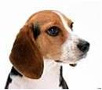
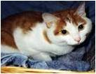
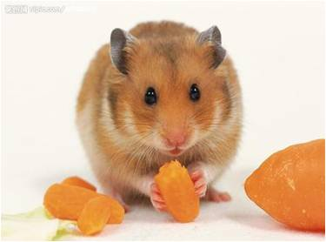
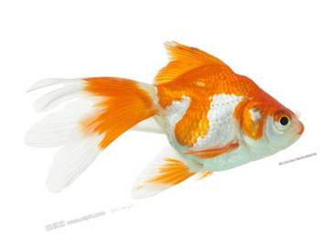
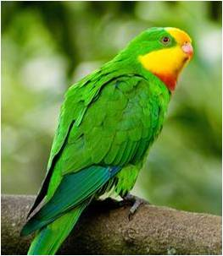
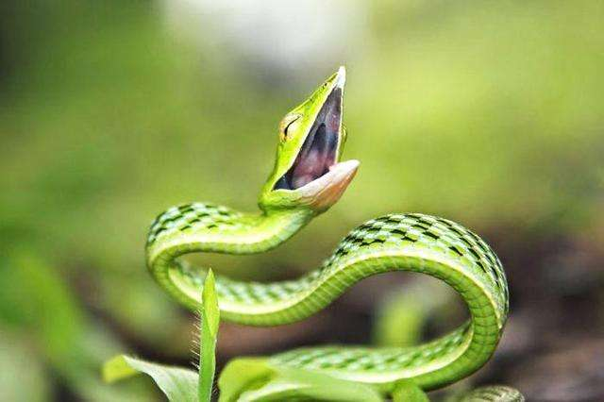
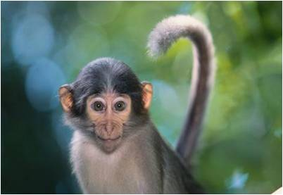
dog
cat
rabbit
hamster
Pair work:
A: What kind of animal do you want to keep
as a pet?
B: ….
A: Why?
B: I like/love….because….
What kind of animal do you want to keep as a pet? Why?
goldfish
parrot
snake
monkey

Slide 20

Language points
1. That’s it. 这就对了。
that’s it：used to say that sb is right, or is doing sth right。用于口语，此处表示：这就对了；正是这样
(1) No, the other one… that’s it.
(2) That’s it, carry on!
(3) Slowly ... slowly. Yeah, that’s it.
不，是另一个……对了，就是那个。
就是这样，继续！
慢一点，慢一点。对了，就是这样。

Slide 21


2. … I like watching them swim around.
……我喜欢看着他们游来游去。
watch sb do sth “看见某人做某事”，
动词用原形强调动作的全过程。常用于该用法的动词还有see、hear等。
Practice
1) 我看见他偷了那本书。
I watched him steal that book.
2) 我们经常会听到你的妹妹唱那首歌。
We often hear your sister sing that song.
3) 我看到她打扫教室了。
I saw her clean the classroom.

Slide 22

3. I like my rabbit because I can feed her carrots and I like her long ears.
feed: v. to give food to a person, group, or animal “喂，喂养”,其过去式是fed。
feed sb. sth. = feed sth. to sb. 喂某人某物
Practice
1) 他喜欢给他的狗喂骨头。
He likes feeding bones to his dog.
= He likes feeding his dog bones.
2) 这些孩子们喜欢给鸭子喂面包。
The kids love feeding bread to the ducks.
=The kids love feeding the ducks bread.

Slide 23
4. I love my parrot because he can sing, and I want to teach him to speak.
teach v. to give someone knowledge or to train someone; to instruct “教”，过去式是taught。 teach sb. to do sth. 教某人做某事
Practice
1) 她教我学英语。
She teaches me to learn English.
2) 谁教你做饭的？
Who taught you to cook?
3) 我爸爸教过我游泳。
My father taught me to swim.

Slide 24


Quiz
注: 另附word文档。
点击此处链接

Slide 25

olding
Sue: What are you (1) h_______ in your hand?
Tom: A photo of a cat.
Sue: Let me have a look. Oh, how lovely the cat is!
Tom: Yes. It’s my cousin’s cat. I want to keep a cat as a
(2) p ___, too.
Sue: That’s a good idea. Do you know how to look after a cat?
Tom: Yes. Last week, my cousin (3) t _________ me how to look after a cat.
Sue:Why do you want to have a cat?
Tom: First, the cat is very easy to look after. I don’t need to (4) f _____it much food. I don’t need to take it for a walk. It can look after itself. Second, it can catch (捉) (5) m ___.
Third, I can play with it and have fun. My cousin’s cat likes sitting on her (6) k _____ . I hope mine can do that too.
Sue: I see. Animals are our friends. We shouldn’t be
(7) r ____ to them.
Tom: You’re right. I will be kind to my cat and look after it
well.
et
I.阅读下面的对话，根据所给的首字母提示，用合适的单词填空。
aught/old
eed
ice
nees
ude

Slide 26
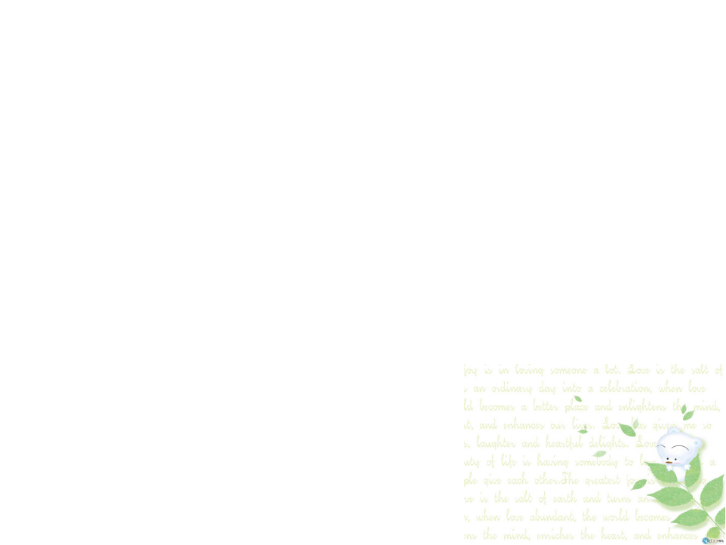
Ⅱ.翻译下列句子
我的女儿非常喜欢看鱼儿游来游去。
My daughter likes watching the fish swim around very much.
2. 我常常给我的兔子喂胡萝卜。
I often feed my rabbit carrots.
3. 我的小猫喜欢在我膝盖上睡觉。
My little cat loves to sleep on my knees.
4. 我想教鹦鹉说“早上好”。
I want to teach a parrot to say “Good
morning.”

Slide 27

Homework
Finish the exercises in Learning English.
Preview the two poems My dog & My goldfish on page 94.

